Slide 1
Welcome!
Our class 8 NGUYEN THI THAP Secondary school

Slide 2
WARMER: Jumbled words
What folk tales are these?
1.
One hundred- section bamboo
2.
The Frog Prince
3.
The seven- mile shoes
Snow White and the 7 Dwarfs
4.

Slide 3
Unit 4: Our past Section: READ 1& 2
I. Vocabulary:
1. cruel ( adj ) : độc ác
to be cruel to ( so ):độc ác với ai
2. (to) upset ( so ): ( to ) make ( so ) feel unhappy
3. ( a ) fairy: nàng tiên
magical
A fairy has a lot of ...................... powers
4. magically ( adv ) : kỳ diệu.
5. rag ( n): quần áo rách, vải vụn
6. (to ) fall in love with ( so ): phải lòng ( ai )
immediately
When the Prince saw Tấm, he .......................... fell in love with her.
7. immediately ( adv ): ngay lập tức

Slide 4
II. Matching
1. (to) upset
2. rags
3. (to) fall in love
4. magically
5. immediately
6. fair
7. cruel
a. phải lòng (ai)
b. nàng tiên
c. làm (ai) đau khổ
d. độc ác
e. kỳ diệu
f. áo quần rách rưới
g. ngay lập tức

Slide 5
THE LOST SHOE
Once a poor farmer had a daughter named Little Pea.After his wife died, the farmer married again. His new wife had a daughter, Stout Nut.
Unfortunately, the new wife was very cruel to Little Pea. Little Pea had to do chores all day. This made Little Pea’s father very upset. He soon died of a broken heart.
Summer came and went. In the fall, the village held its harvest festival. That year, everyone was excited as the prince wanted to choose his wife from the village.Stout Nut’s mother made new clothes for her, but poor Little Pea had none.
However, before the festival started, a fairy appeared and magically changed Little Pea’s rags into beautiful clothes.
As Little Pea ran to the festival, she dropped one of her shoes and lost it .When the prince found the shoe, he decided to marry the girl who owned it. Of course , the shoe fitted Little Pea,and the prince immediately fell in love with her.

Slide 6
III.True / False Statement Predictions
A.Little Pea’s father is a rich farmer.
False->Little Pea’s father is a rich farmer.
B.Her father got married again after his wife died.
C.Her step-mother was beautiful and nice to her.
False->Her step-mother was cruel to her.
D.Little Pea worked hard all day.
E.Little Pea could go to the festival because her step-mother made her beautiful clothes.
False-> Little Pea could go to the festival because a fairy made her beautiful clothes.
F.Finally the Prince decided to marry Little Pea.
True
True
True

Slide 7
V. Gap - Fill
farmer
Little Pea’s father was a ......................
Little Pea’s mother ...............when she was young.
Little Pea .......................to do the housework all day after her father got married................
The Prince wanted to ...........................a girl from Little Pea’s village.
Stout Nut’s mother did not make.................. ...............for Little Pea.
The Prince found Little Pea’s ............shoe.
died
had/ used
again
marry/ choose
new
clothes
lost

Slide 8
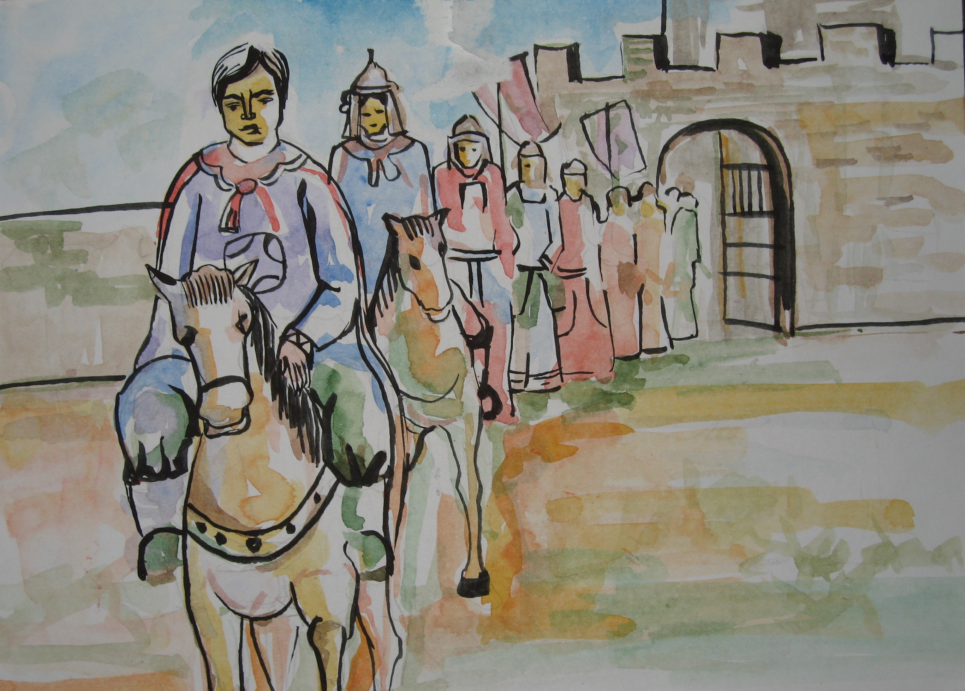
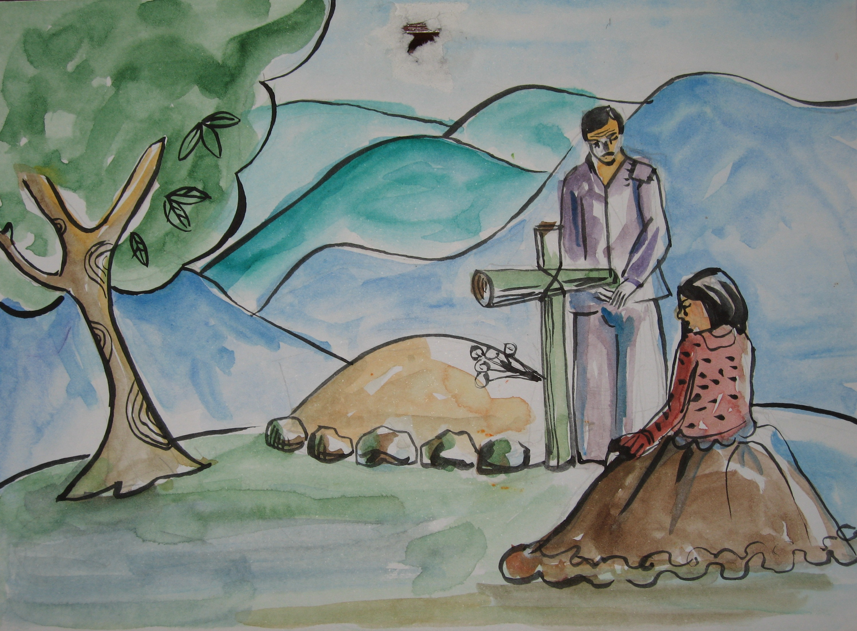
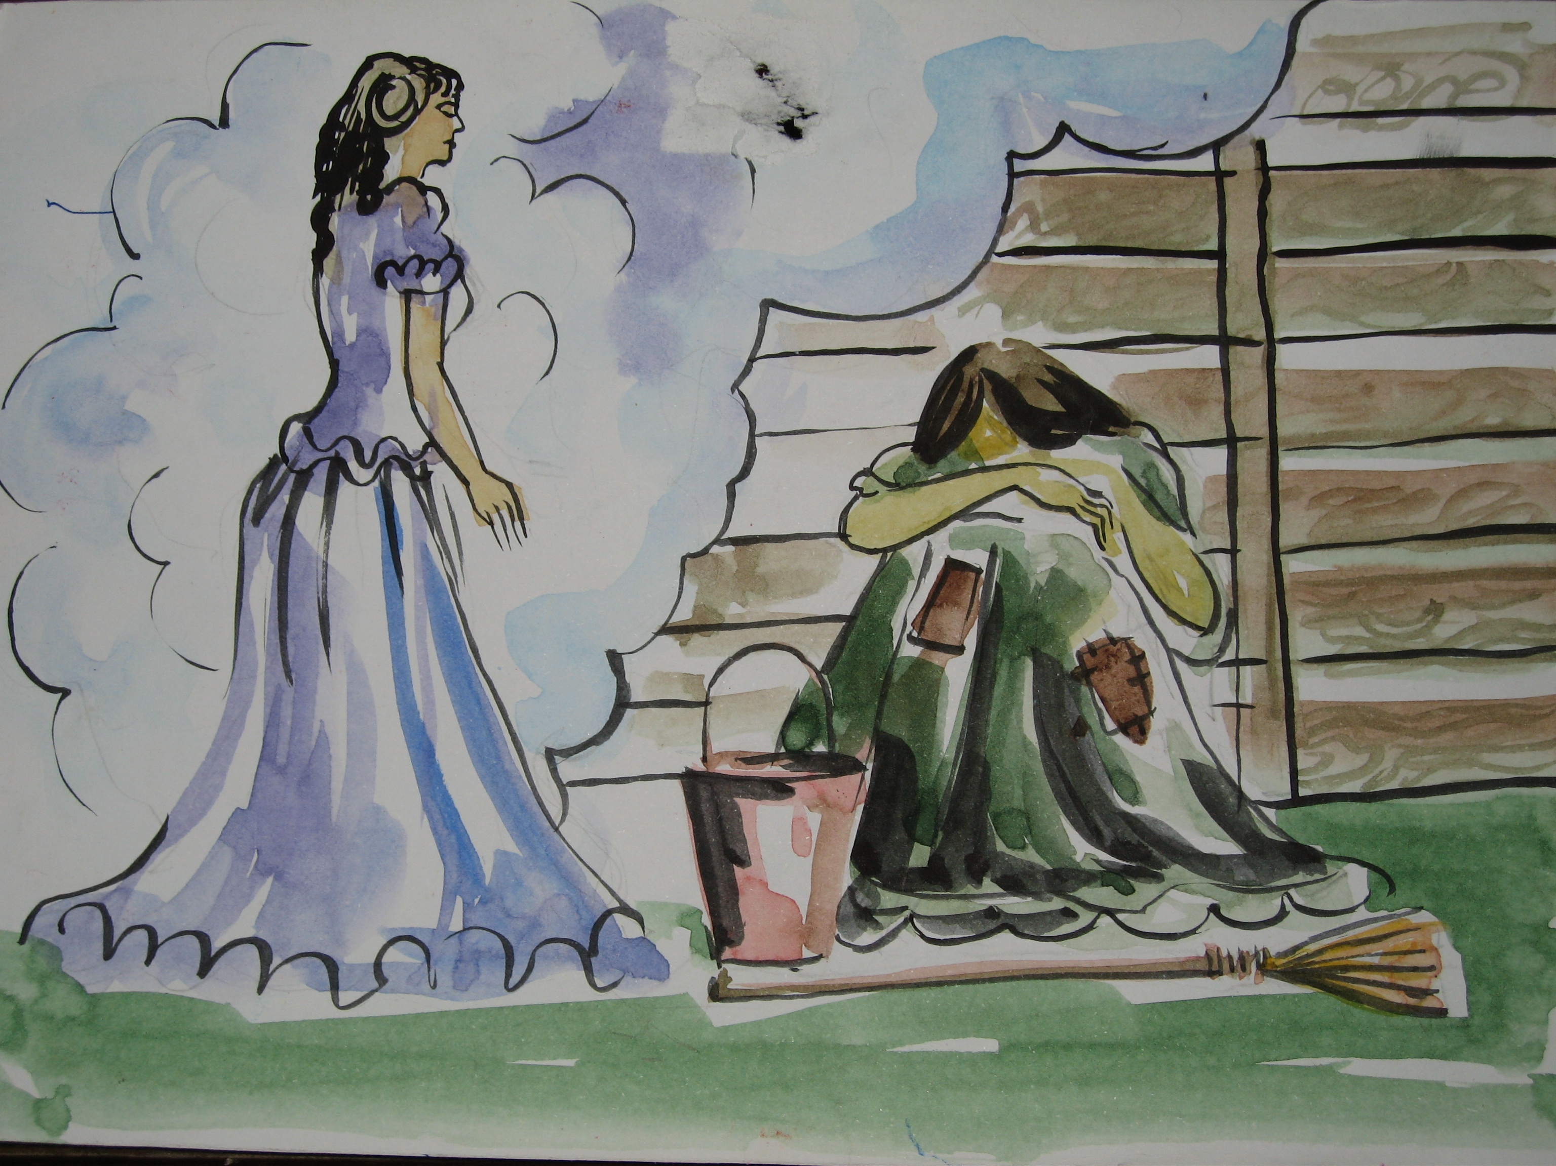
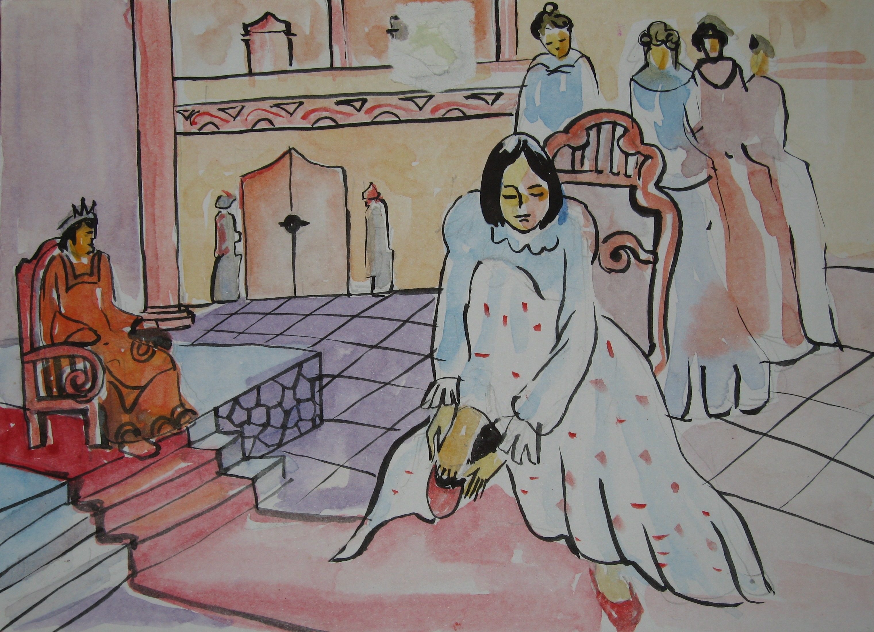
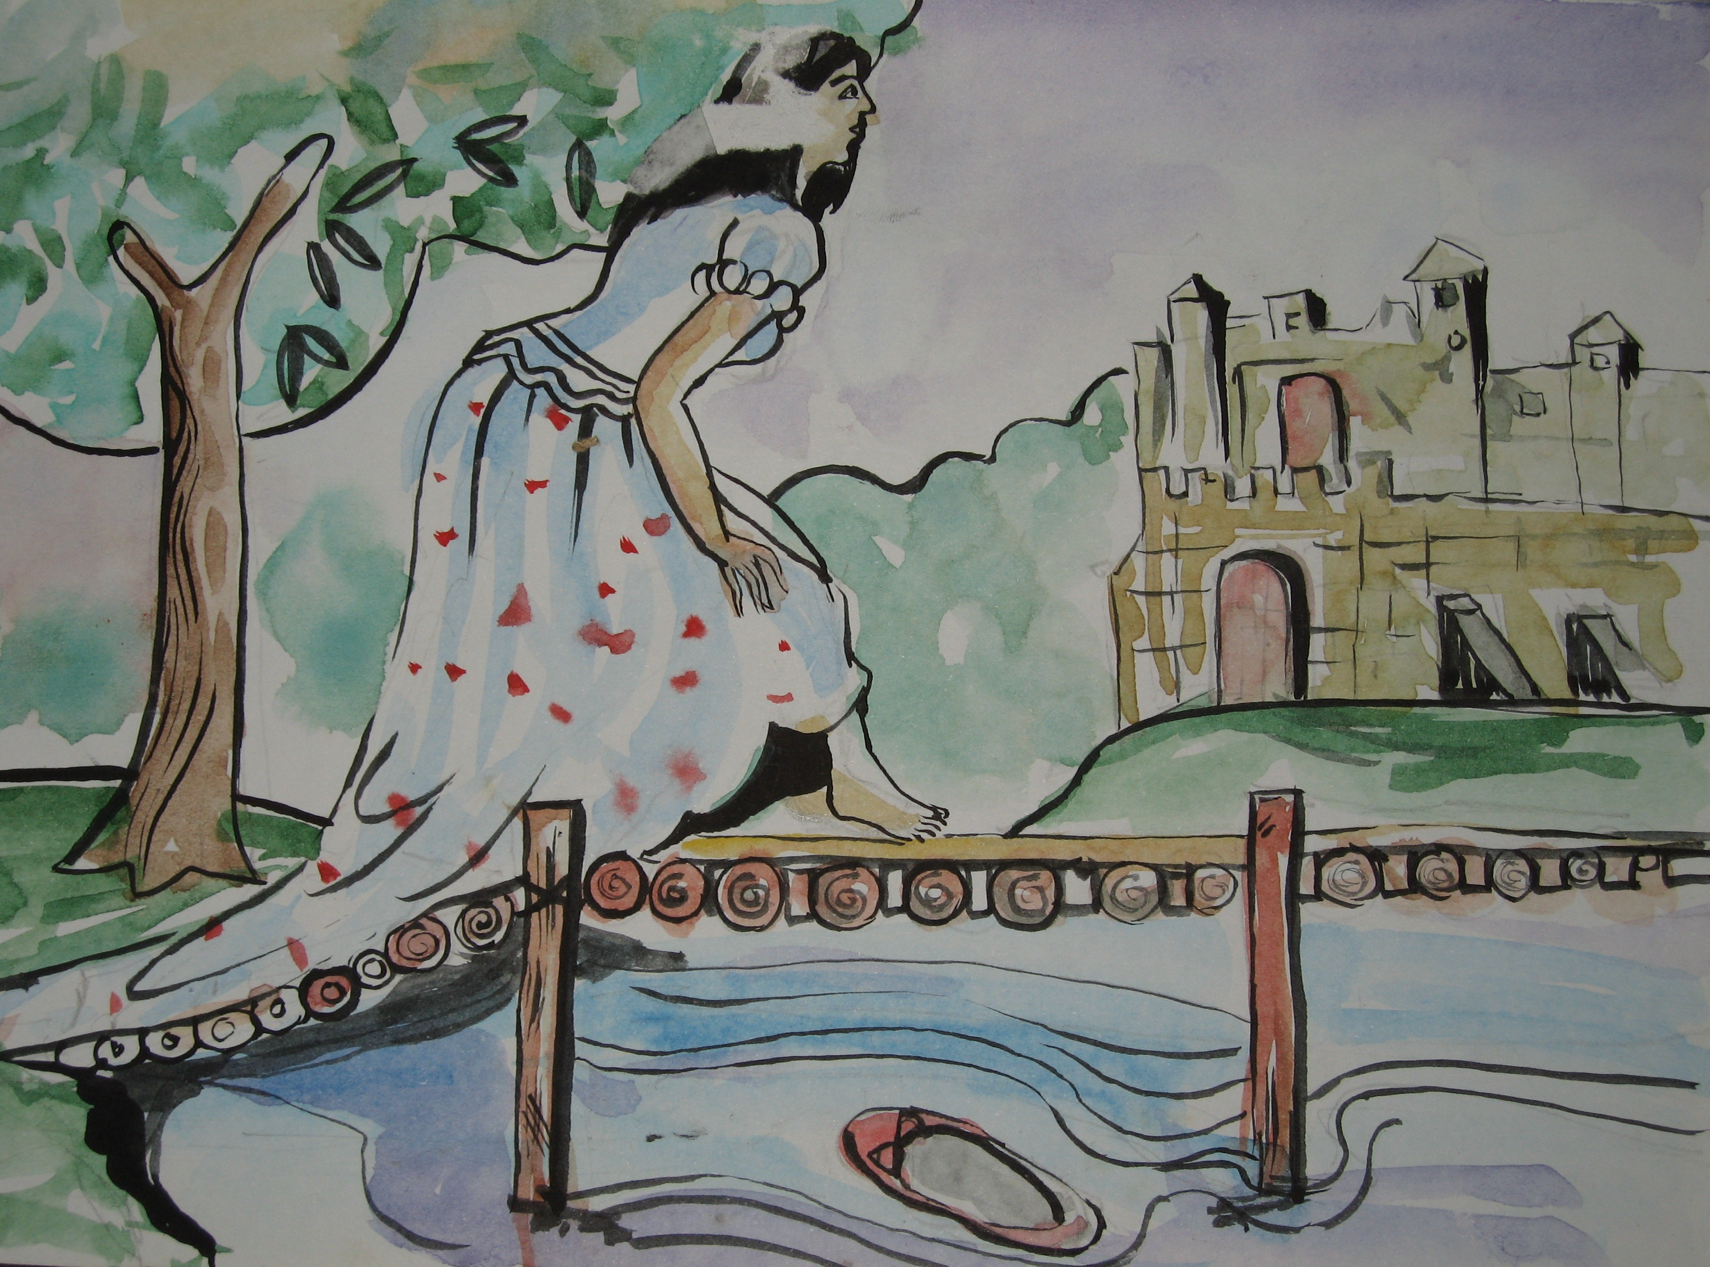
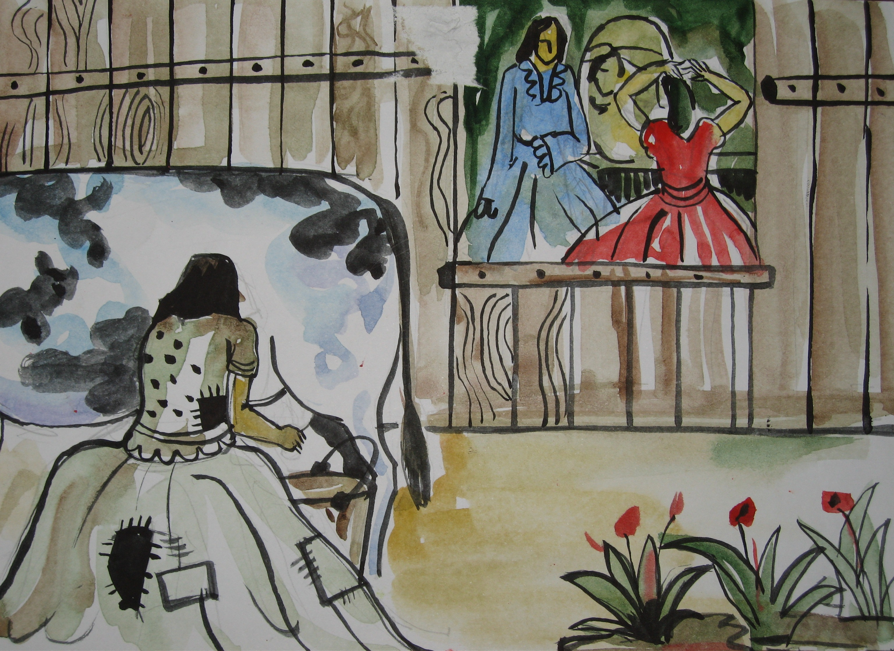
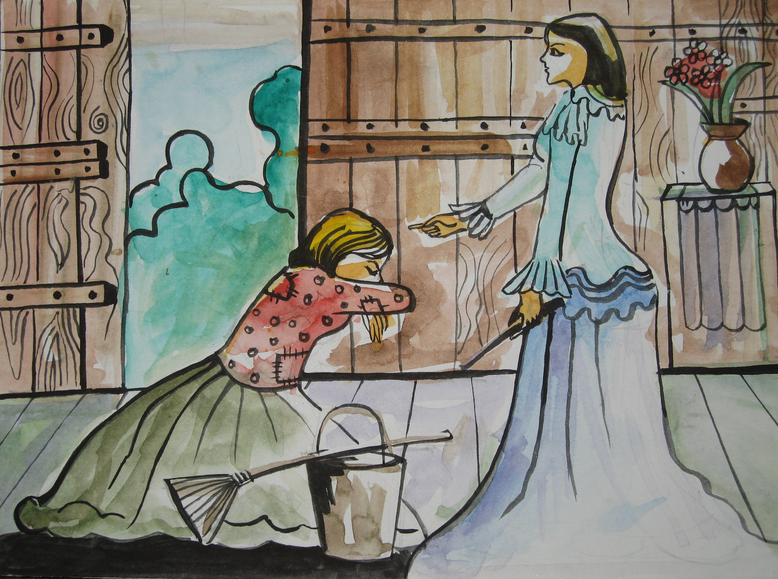
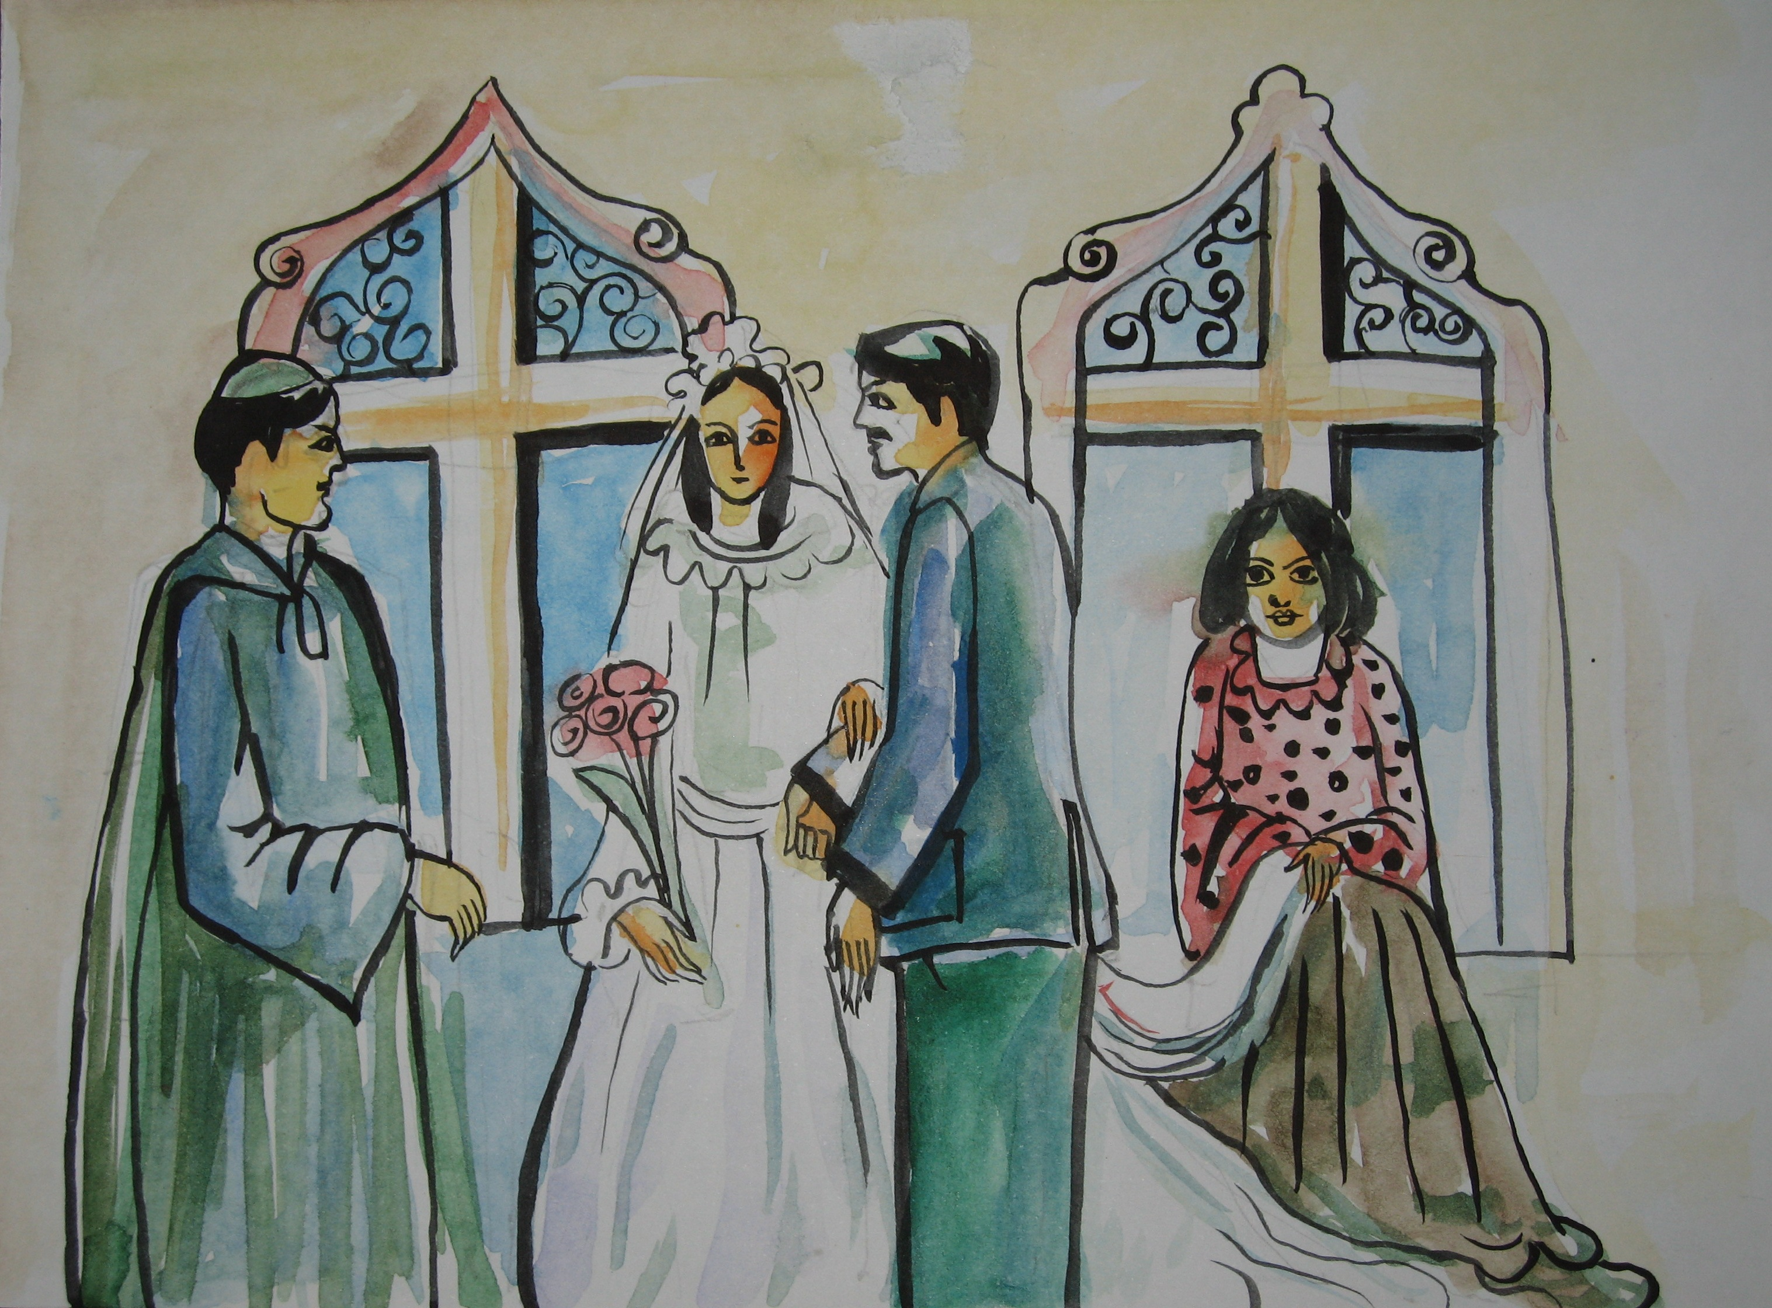
VI. Ordering pictures
a
b
c
d
e
f
g
h
i
j

Slide 9
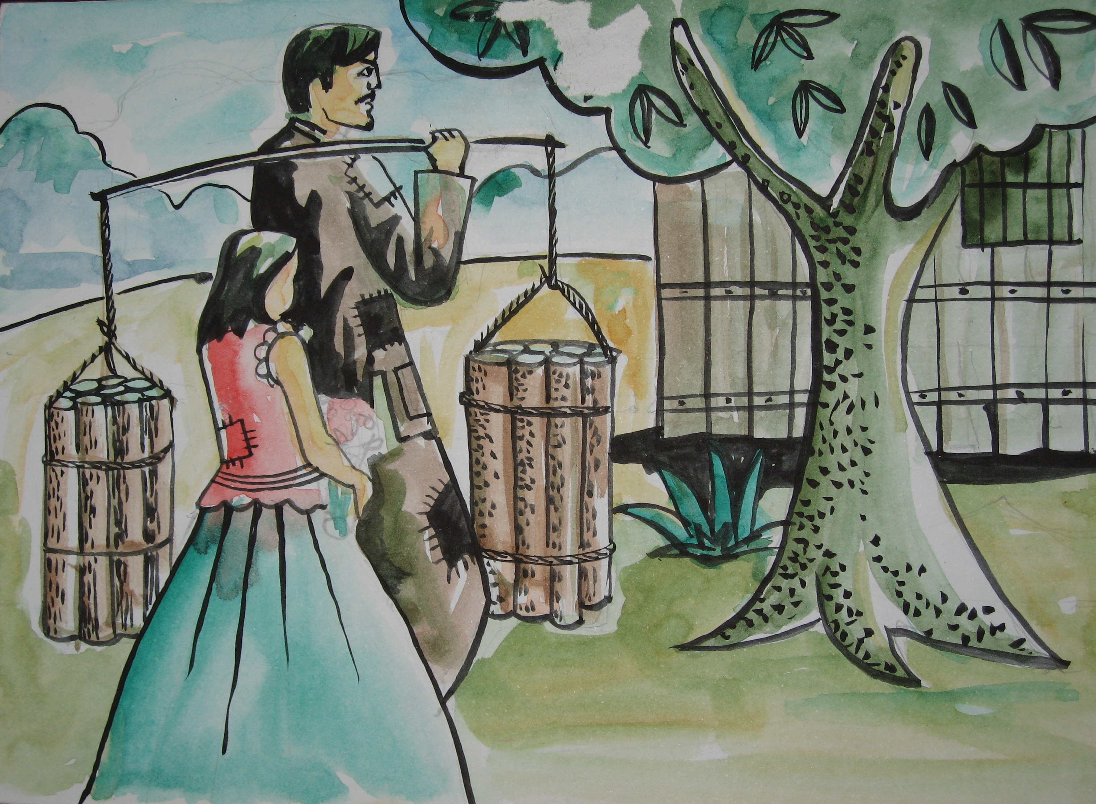
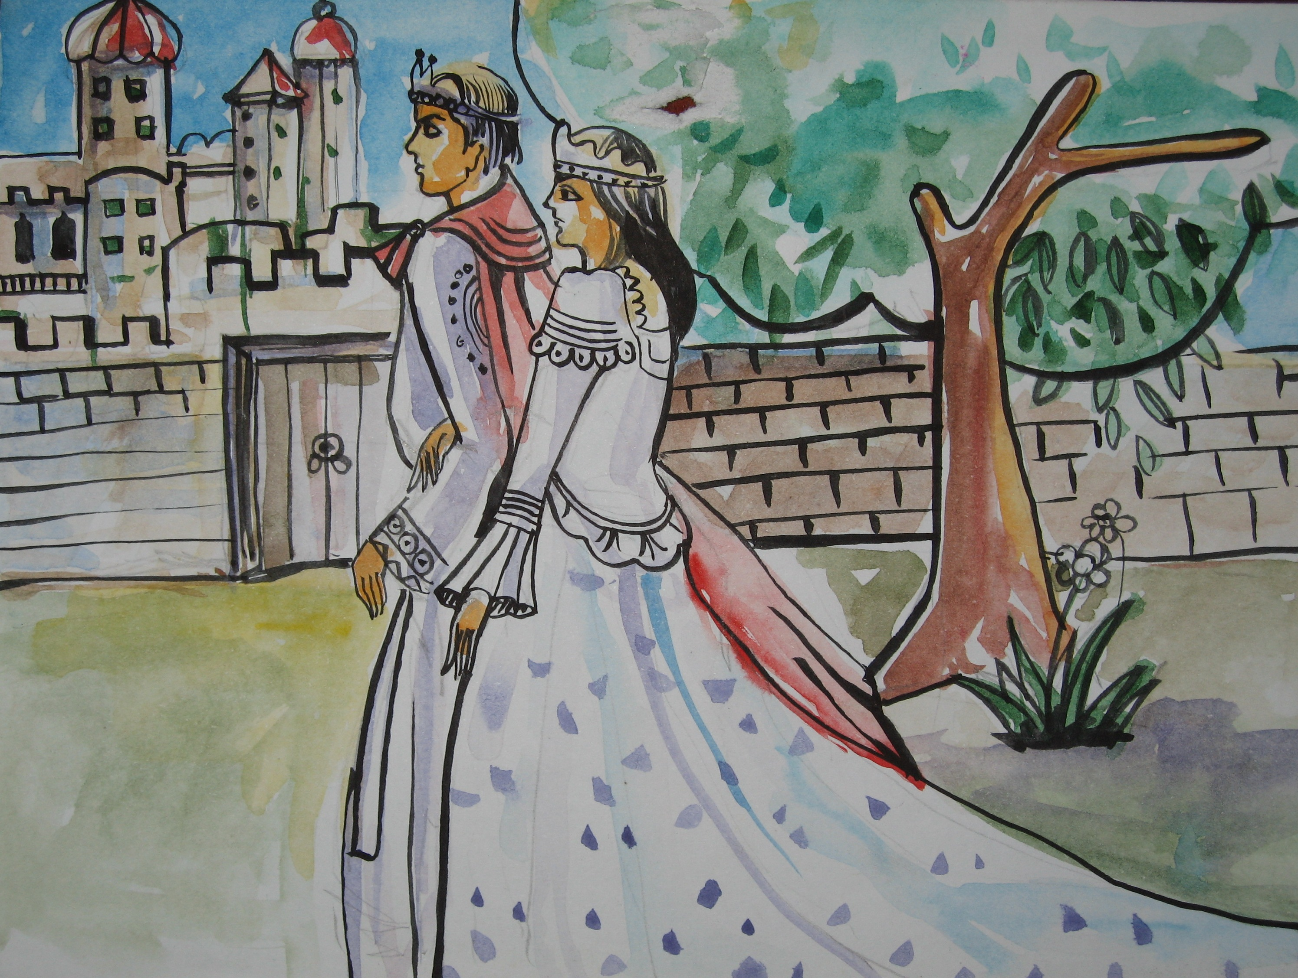
1g
2b
3i
4c
5a
6d
7e
8f
9h
10j

Slide 10
Homework
Rewrite the story in your exercise notebooks.
Answer the questions in Sec. 2 (p.42)
Prepare next lesson – lesson 4 write

Slide 11
THANK YOU!

